Slide 1
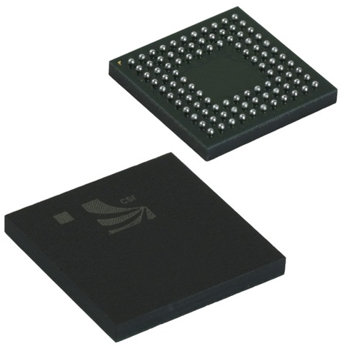
INTRODUCTION TO VERILOG

Slide 2
VERILOG HDL
Basic Unit – A module
Module
  Describes the functionality of the design
  States the input and output ports
Example: A Computer
  Functionality: Perform user defined computations
  IP Ports: Keyboard, Mouse
  OP ports : Monitor, Printer

Slide 3
Module
General definition
module module_name ( port_list );
port declarations;
…
variable declaration;
…
description of behavior
endmodule
Example
module HalfAdder (A, B, Sum Carry);
input A, B;
output Sum, Carry;
assign Sum = A ^ B;
//^ denotes XOR
assign Carry = A & B;
// & denotes AND
endmodule

Slide 4
Lexical Conventions
Comments
  // Single line comment
  /* Begins multi-line (block) comment
  */
Number
  decimal, hex, octal, binary
  unsized decimal form
  size base form
  include underlines, +,-
String
  " Enclose between quotes on a single line"

Slide 5
Lexical Conventions (cont.)
Identifier
  A ... Z
  a ... z
  0 ... 9
  Underscore
Strings are limited to 1024 chars
First char of identifier must not be a digit
Verilog is case sensitive

Slide 6
Data Types
Data Values:
0,1,x,z
Wire
Synthesizes into wires
Used in structural code
Reg
May synthesize into latches, flip-flops or wires
Used in procedural code
Integer
32-bit integer used as indexes
Input, Output, inout
Defines ports of a module (wire by default)
module sample (a,b,c,d);
input a,b;
output c,d;
wire [7:0] b;
reg c,d;
integer k;

Slide 7
Data Types
Net Type: Wire
  wire [ msb : lsb ] wire1, wire2, …
  Example
  wire Reset; // A 1-bit wire
  wire [6:0] Clear; // A 7-bit wire
Register Type: Reg
  reg [ msb : lsb ] reg1, reg2, …
  Example
  reg [ 3: 0 ] cla; // A 4-bit register
  reg cla; // A 1-bit register

Slide 8
Data Values
Numbers:
Numbers are defined by number of bits
Value of 23:
5’b10111
5’d23
5’h17
Constants:
wire [3:0] t,d;
assign t = 23;
assign d= 4’b0111;
Parameters:
parameter n=4;
wire [n-1:0] t, d;
`define Reset_state = 0, state_B =1, Run_state =2, finish_state = 3;
if(state==`Run_state)

Slide 9
Operators
Arithmetic:
*,+,-, /,%
Relational
<,<=,>,>=,==, !=
Bit-wise Operators
Not: ~
XOR: ^
And : & 5’b11001 & 5’b01101 ==> 5’b01001
OR: |
XNOR: ~^ or ^~
Logical Operators
Returns 1or 0, treats all nonzero as 1
! : Not
&& : AND 27 && -3 ==> 1
|| : OR
reg [3:0] a, b, c, d;
wire[7:0] x,y,z;
parameter n =4;
c = a + b;
d = a *n;
If(x==y) d = 1; else d =0;
d = a ~^ b;
if ((x>=y) && (z)) a=1;
else a = !x;

Slide 10
Operators
Reduction Operators:
Unary operations returns single-bit values
& : and
| :or
~& : nand
~| : nor
^ : xor
~^ :xnor
Shift Operators
Shift Left: <<
Shift right: >>
Concatenation Operator
{ } (concatenation)
Conditional Operator
Implements if-then-else statement
(cond) ? (result if cond true) : (result if cond false)

Slide 11

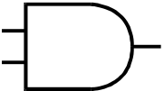
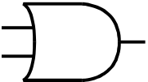
Description Styles
Structural: Logic is described in terms of Verilog gate primitives
Example:
not n1(sel_n, sel);
and a1(sel_b, b, sel_b);
and a2(sel_a, a, sel);
or o1(out, sel_b, sel_a);
b
sel
a1
sel_b
n1
sel_n
o1
out
a
a2
sel_a

Slide 12
Description Styles (cont.)
Dataflow: Specify output signals in terms of input signals
Example:
assign out = (sel & a) | (~sel & b);
b
sel
sel_b
sel_n
out
sel_a
a

Slide 13
Description Styles (cont.)
Behavioral: Algorithmically specify the behavior of the design
Example:
if (select == 0) begin
out = b;
end
else if (select == 1) begin
out = a;
end
a
Black Box
2x1 MUX
out
b
sel

Slide 14
Structural Modeling
Execution: Concurrent
Format (Primitive Gates):
  and G2(Carry, A, B);
First parameter (Carry) – Output
Other Inputs (A, B) - Inputs

Slide 15
Dataflow Modeling
Uses continuous assignment statement
  Format: assign [ delay ] net = expression;
  Example: assign sum = a ^ b;
Delay: Time duration between assignment from RHS to LHS
All continuous assignment statements execute concurrently
Order of the statement does not impact the design

Slide 16
Dataflow Modeling (cont.)
Delay can be introduced
  Example: assign #2 sum = a ^ b;
  “#2” indicates 2 time-units
  No delay specified : 0 (default)
Associate time-unit with physical time
  `timescale time-unit/time-precision
  Example: `timescale 1ns/100 ps
Timescale
`timescale 1ns/100ps
  1 Time unit = 1 ns
  Time precision is 100ps (0.1 ns)
  10.512ns is interpreted as 10.5ns

Slide 17
Dataflow Modeling (cont.)
Example:
    `timescale 1ns/100ps
    module HalfAdder (A, B, Sum, Carry);
    input A, B;
    output Sum, Carry;
    assign #3 Sum = A ^ B;
    assign #6 Carry = A & B;
    endmodule

Slide 18
Behavioral Modeling
Example:
  module mux_2x1(a, b, sel, out);
  input a, b, sel;
  output out;
  always @(a or b or sel)
  begin
  if (sel == 1)
  out = a;
  else out = b;
  end
  endmodule
Sensitivity List

Slide 19
Behavioral Modeling (cont.)
always statement : Sequential Block
Sequential Block: All statements within the block are executed sequentially
When is it executed?
  Occurrence of an event in the sensitivity list
  Event: Change in the logical value
Statements with a Sequential Block: Procedural Assignments
Delay in Procedural Assignments
  Inter-Statement Delay
  Intra-Statement Delay

Slide 20
Procedural Constructs
Two Procedural Constructs
  initial Statement
  always Statement
initial Statement : Executes only once
always Statement : Executes in a loop
Example:
  …
  initial begin
  Sum = 0;
  Carry = 0;
  end
  …
  …
  always @(A or B) begin
  Sum = A ^ B;
  Carry = A & B;
  end
  …

Slide 21
Event Control
Event Control
  Edge Triggered Event Control
  Level Triggered Event Control
Edge Triggered Event Control
  @ (posedge CLK) //Positive Edge of CLK
  Curr_State = Next_state;
Edge Triggered Event Control
  @ (negedge CLK) //Negative Edge of CLK
  Curr_State = Next_state;
Level Triggered Event Control
  @ (A or B) //change in values of A or B
  Out = A & B;

Slide 22
Loop Statements
Loop Statements
  Repeat
  While
  For
Repeat Loop
  Example:
    repeat (Count)
    sum = sum + 5;

Slide 23
Loop Statements (cont.)
While Loop
  Example:
    while (Count < 10) begin
    sum = sum + 5;
    Count = Count +1;
    End
For Loop
  Example:
    for (Count = 0; Count < 10; Count = Count + 1) begin
    sum = sum + 5;
    end

Slide 24
Conditional Statements
Example:
    if (Clk)
    Q = 0;
    else
    Q = D;
if Statement
Format:
  if (condition)
  procedural_statement
  else if (condition)
  procedural_statement
  else
procedural_statement

Slide 25
Conditional Statements (cont.)
Case Statement
Example 1:
    case (X)
    2’b00: Y = A + B;
    2’b01: Y = A – B;
    2’b10: Y = A / B;
    endcase
Example 2:
case (3’b101 << 2)
3’b100: A = B + C;
4’b0100: A = B – C;
5’b10100: A = B / C; //This statement is executed
endcase

Slide 26
Restrictions on Data Types
Data Flow and Structural Modeling
  Can use only wire data type
  Cannot use reg data type
Behavioral Modeling
  Can use only reg data type (within initial and always constructs)
  Cannot use wire data type

Slide 27
Compiler Directives
`define – (Similar to #define in C) used to define global parameter
Example:
  `define BUS_WIDTH 16
  reg [ `BUS_WIDTH - 1 : 0 ] System_Bus;
`undef – Removes the previously defined directive
Example:
  `define BUS_WIDTH 16
  …
  `undef BUS_WIDTH

Slide 28
Compiler Directives (cont.)
`include – used to include another file
Example
  `include “./fulladder.v”

Slide 29
System Tasks
Display tasks
  $display : Displays the entire list at the time when statement is encountered
  $monitor : Whenever there is a change in any argument, displays the entire list at end of time step
Simulation Control Task
  $finish : makes the simulator to exit
  $stop : suspends the simulation
Time
  $time: gives the simulation

Slide 30
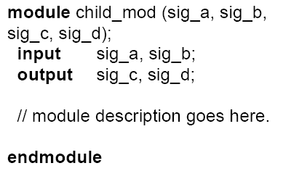
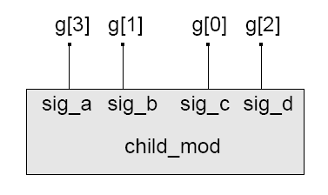
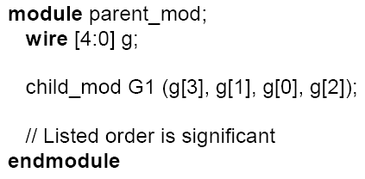
Type of Port Connections
Connection by Position
parent_mod

Slide 31
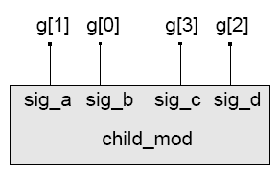
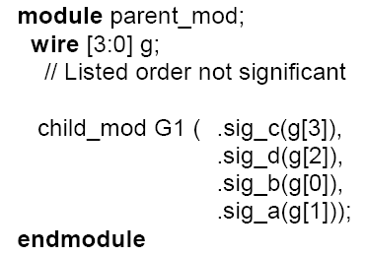
Type of Port Connections (cont.)
Connection by Name
parent_mod

Slide 32
Empty Port Connections
If an input port of an instantiated module is empty, the port is set to a value of z (high impedance).
module child_mod(In1, In2, Out1, Out2) module parent_mod(…….)
input In1;
input In2; child_mod mod(A, ,Y1, Y2);
output Out1; //Empty Input
output Out2; endmodule
//behavior relating In1 and In2 to Out1
endmodule
If an output port of an instantiated module is left empty, the port is considered to be unused.
module parent_mod(…….)
child_mod mod(A, B, Y1, ); //Empty Output
endmodule

Slide 33
Example Problems

Slide 34
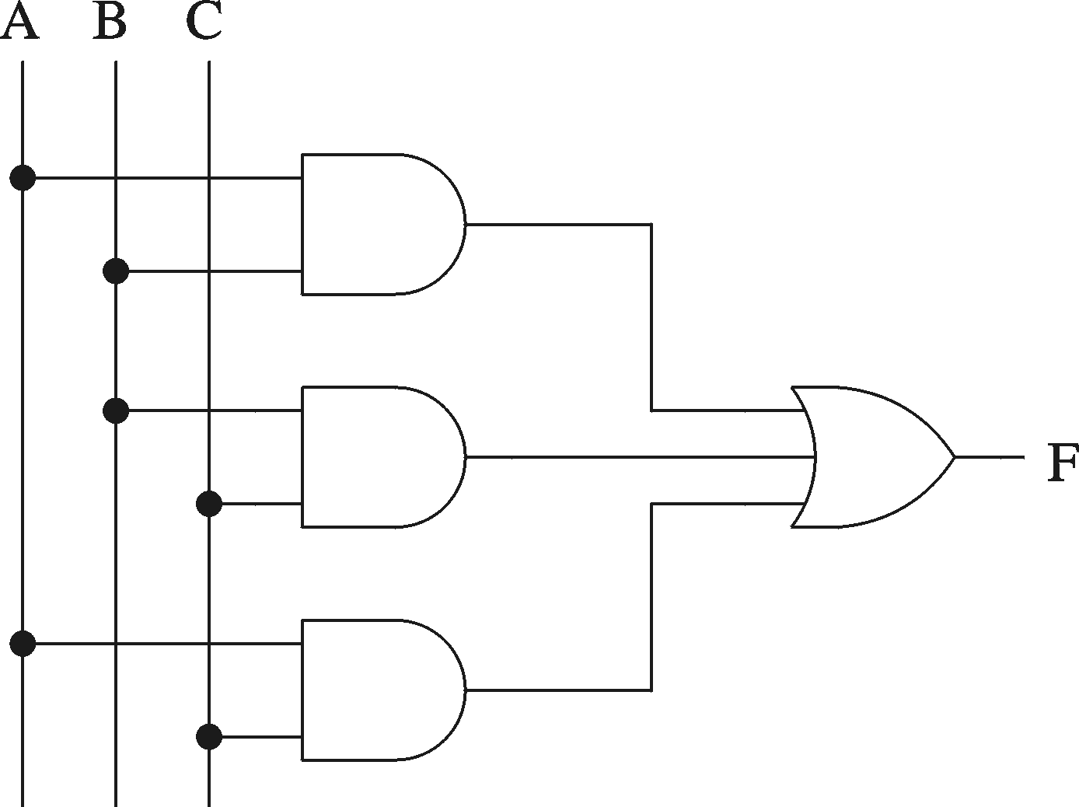
Implement using Data Flow Approach
Truth table
A B C F
0 0 0 0
0 0 1 0
0 1 0 0
0 1 1 1
1 0 0 0
1 0 1 1
1 1 0 1
1 1 1 1
Logical expression form
F = A B + B C + A C
Graphical schematic form

Slide 35
Implement using Data Flow Approach
Truth table
A B C F
0 0 0 0
0 0 1 0
0 1 0 0
0 1 1 1
1 0 0 0
1 0 1 1
1 1 0 1
1 1 1 1
Logical expression form
F = A B + B C + A C
Graphical schematic form

Slide 36
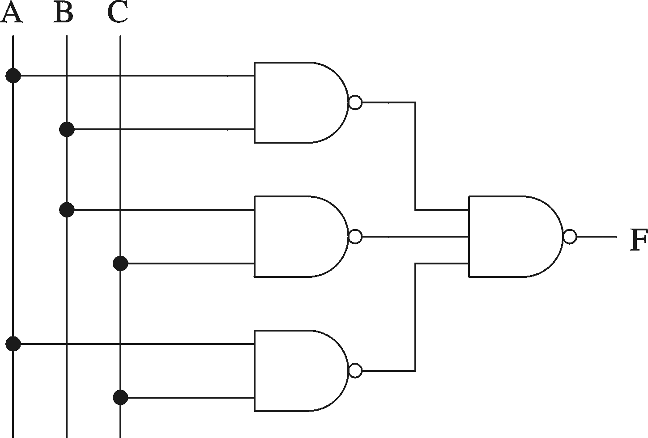
Implement using Data Flow Approach
Majority function

Slide 37
2-to-1 Multiplexer
s
s
f
w
0
0
0
w
w
f
0
1
1
1
w
1
(a) Graphical symbol
(b) Truth table
w
0
s
f
w
1
(c) Sum-of-products circuit

Slide 38
4-to-1 Multiplexer
s
0
s
1
s
1
s
0
f
w
0
00
0
0
w
0
w
1
01
f
0
1
w
1
w
2
10
1
0
w
w
3
11
w
2
1
1
3
(a) Graphic symbol
(b) Truth table
s
0
w
0
s
1
w
1
f
w
2
w
3
(c) Circuit

Slide 39
2-to-4 Decoder
En
w
1
w
0
y
3
y
2
y
1
y
0
w
1
y
3
1
0
0
0
0
0
1
w
y
1
0
1
0
0
1
0
0
2
1
1
0
0
1
0
0
y
1
1
1
1
1
0
0
0
En
y
0
0
-
-
0
0
0
0
(a) Truth table
(b) Graphical symbol
w
0
y
0
w
1
y
1
y
2
y
3
En
(c) Logic circuit

Slide 40
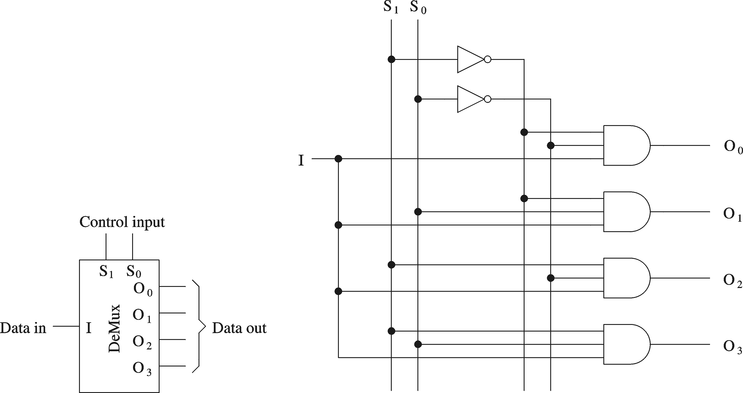
1-to-4 Demultiplexer

Slide 41
Test Bench
`timescale 1ns/100ps
module Top;
reg PA, PB;
wire PSum, PCarry;
HalfAdder G1(PA, PB, PSum, PCarry);
initial begin: LABEL
reg [2:0] i;
for (i=0; i<4; i=i+1) begin
{PA, PB} = i;
#5 $display (“PA=%b PB=%b PSum=%b PCarry=%b”, PA, PB, PSum, PCarry);
end // for
end // initial
endmodule
Test Bench
Apply Inputs
Design
Module
Observe Outputs

Slide 42
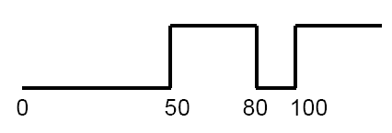
Test Bench - Generating Stimulus
Example: A sequence of values
  initial begin
  Clock = 0;
  #50 Clock = 1;
  #30 Clock = 0;
  #20 Clock = 1;
  end

Slide 43
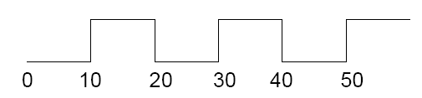
Test Bench - Generating Clock
Repetitive Signals (clock)
Clock
A Simple Solution:
  wire Clock;
  assign #10 Clock = ~ Clock
Caution:
  Initial value of Clock (wire data type) = z
  ~z = x and ~x = x

Slide 44
Test Bench - Generating Clock (cont.)
Initialize the Clock signal
    initial begin
    Clock = 0;
    end
Caution: Clock is of data type wire, cannot be used in an initial statement
Solution:
    reg Clock;
    …
    initial begin
    Clock = 0;
    end
    …
    always begin
    #10 Clock = ~ Clock;
    end
forever loop can
also be used to
generate clock

